Slide 1

Stockie: Stock Trading System
STOCKIE
The Money-Making Machine
Flatiron Final Project
By
Frank Kornet
@frkornet@gmail.com

Slide 2
Topics
Why a Stock Trading System?
Envisaged => Implemented Trading System
Limitations/Issues & Performance
Version 2 Blueprint
Acknowledgements
Notes:
Overview of presentation.

Slide 3
Why a Stock Trading System?
Oracle annual stock bonus allowed me to pay down most of the cost of my first house
I started to follow and invest in stocks over the years as a result
I attended an MBA (partly) to learn about companies and finance
At my MBA, the Capital Asset Pricing Model was drilled into students (including me!)
Finance has in the meantime moved on and recognizes that CAPM is a simplistic model and that not all the stock market is efficient
I wanted to see if we can exploit the inefficiencies in the stock market
Time series are widely applicable (well logs, medical records, etc)

Slide 4
Envisaged Trading System
Sold Stocks
Components:
The blue parts were developed as part of Module 4 project, giving final project a head start
Two types of models envisaged to predict whether stocks are going up or not
The middle part integrates both recommendations to identify buy opportunities
The top part shows that buy decisions are verified by a human and then added to ledger after buying
Ledger
(P & L)
Update
Local Max
Confirmed
Buys
Confirmed
Buys
Daily Sell
Recommendations
Hourly Stock
Data
Top Daily
Buy Recommendations
Market Trend
Up
Sideways
Down
E(ret)
Momentum
E(ret)
Swing
Up
2moro
Up in
3 days
Up in
5 days
Up in
10 days
Local
Min
Local
Max
Set of 100 stocks
Notes:
.Summarize what was developed as part of module 4 project. Also, document the findings. Highlight 1-day model unreliable and dropped as a consequence. Added an 8-day model instead. The 8-day model doing much better than 1-day model.
Accuracy of predicting stock market going up is important. You don’t want to predict that the market is going up while it then goes down. This would result in loosing money.

Slide 5
Implemented Trading System
Components:
2,000 stocks instead of 100
Backtesting engine
Forecasting with ARX/GARCH model
Local minima and maxima models
P&L functionality to track performance
Buy recommendations (but not sell)
Hourly updates
backtest_nnn
heuristic
ticker
stats
backtest
exclude
data quality
capital
PnL
possible
trades
Jupyter notebook
Python
CSV file
Notes:
.Summarize what was developed as part of module 4 project. Also, document the findings. Highlight 1-day model unreliable and dropped as a consequence. Added an 8-day model instead. The 8-day model doing much better than 1-day model.
Accuracy of predicting stock market going up is important. You don’t want to predict that the market is going up while it then goes down. This would result in loosing money.

Slide 6

Learnings & Findings
STOCKIE
The Money-Making Machine
Performance gets better as more stocks are added
ARX/GARCH forecasting capability is weak and hence excluded
Local minima and maxima model turns out to be great
The buy recommendation functionality simplified as a result
Stop-loss used to manage downside risk
Heuristics used to differentiate between good and bad stocks
Ranking stocks using mean daily compounded returns of gains

Slide 7
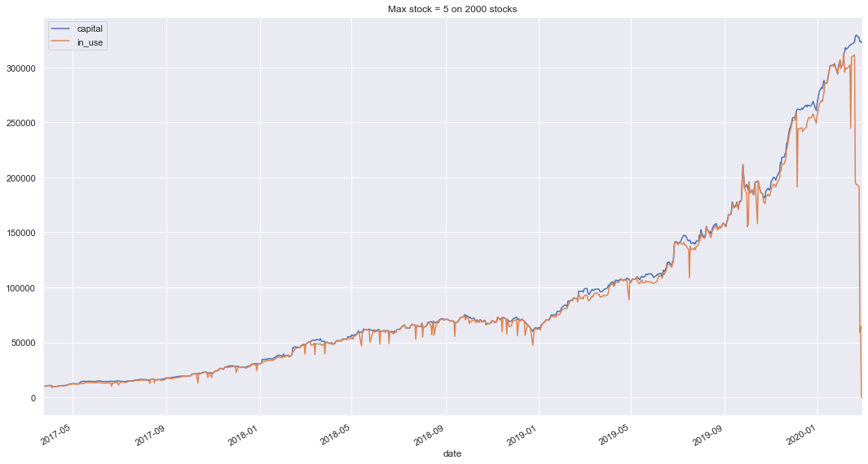
Stockie’s Trading Performance
Starting capital: $10k
Trading period: 732 days
The best result to date: $320k
Compounded daily return: 0.4 – 0.5 % / day

Slide 8
Limitations and Issues
All code in backtest.py (~1200 lines of code)
Backtester function complex and large
Stockie has so far only proven itself in backtesting
Not implemented: sell recommendations, rebalancing, capping holding period if a certain gain has been achieved, portfolio management, and limiting number of trading days
Literature claims ARX/GARCH models are good at predicting stock prices. Are neural networks perhaps better?
The heuristics restrict the 2,000 stocks to 436 good stocks

Slide 9
Stockie V2 Blueprint
Enhancements:
Break up the code & simplify backtester
Implement sell recommendations, rebalancing, capping holding period, and limiting trading days
Running jobs in background
Add BlackRock stocks from F-13 filings
Estimated Effort & Timeline:
Takes 2 – 3 weeks to implement. After which we can start testing how well Stockie does in predicting future stock movements.
Not included: ARX/GARCH, NN, and portfolio management
util
PnL
PnL + capital
strategy
trade
heuristic
possible
trades
exclude
ticker stats
quality.py
Jupyter notebook
Python
CSV file
Notes:
.Summarize what was developed as part of module 4 project. Also, document the findings. Highlight 1-day model unreliable and dropped as a consequence. Added an 8-day model instead. The 8-day model doing much better than 1-day model.
Accuracy of predicting stock market going up is important. You don’t want to predict that the market is going up while it then goes down. This would result in loosing money.

Slide 10
Acknowledgement
Bryan Arnold for his help and ideas. They were instrumental in developing Stockie.
Carson Lloyd for developing a web scraping template for converting CUSIP numbers to stock tickers.

